Slide 1
3D Air Brush
Suriya Dakshina Murthy (suriya@ucsb.edu)

Slide 2
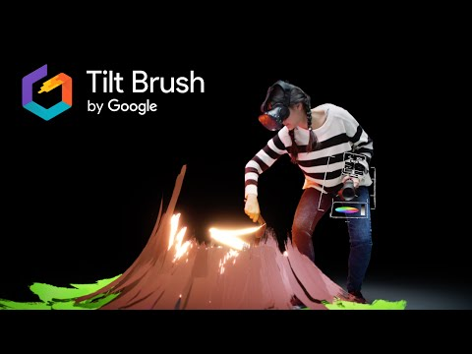
Inspiration
The ideas is similar to Tilt Brush by Google but this is using Mouse and Keyboard for web(p5.js) or desktop app(processing.java).

Slide 3
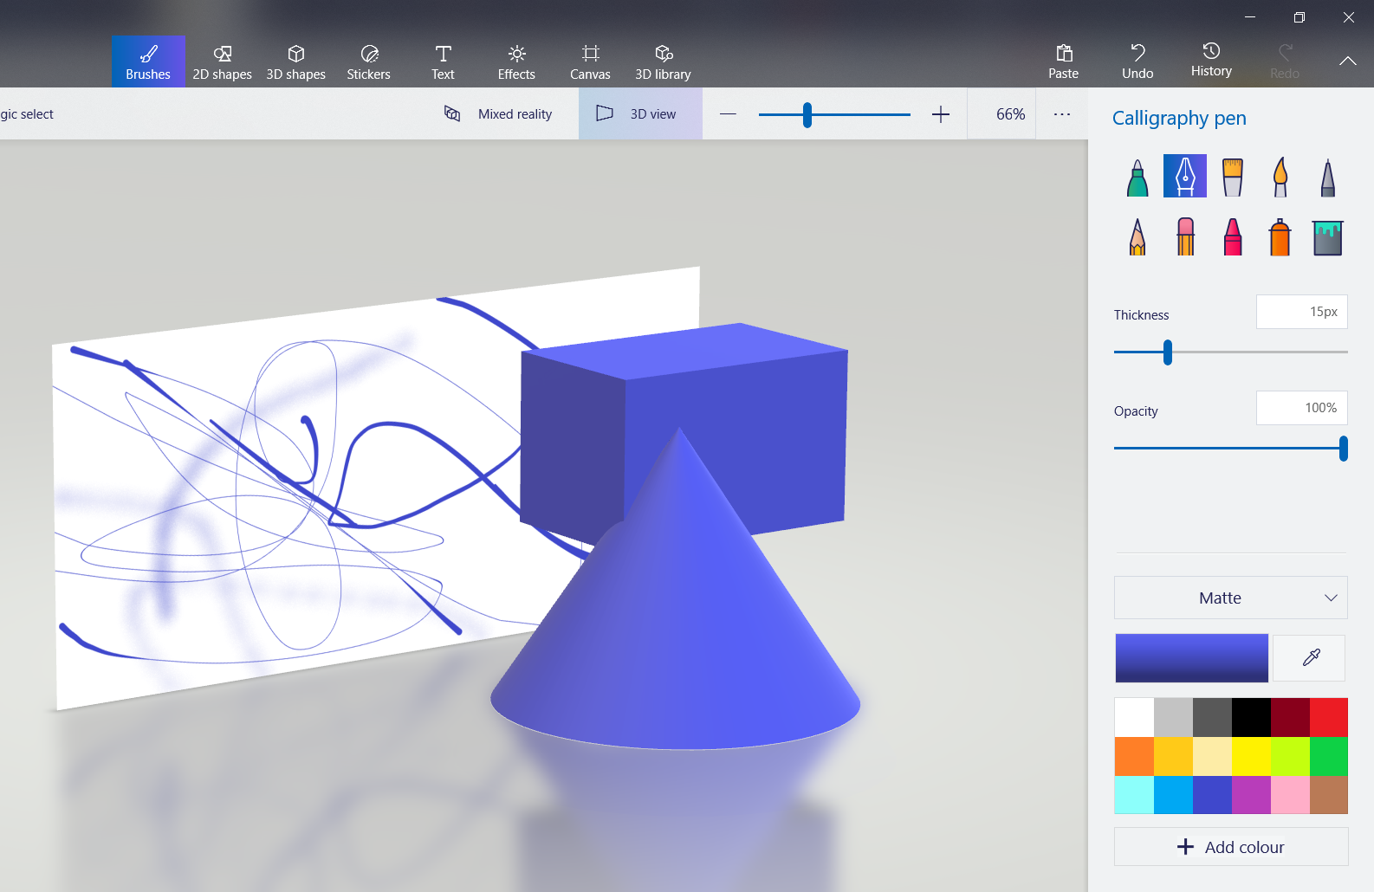
3D Paint in Windows
Windows 10 operating system ships with an application called 3D paint, but the canvas is still a 2D canvas and the brushes are only scoped to paint on the 2D canvas.

Slide 4
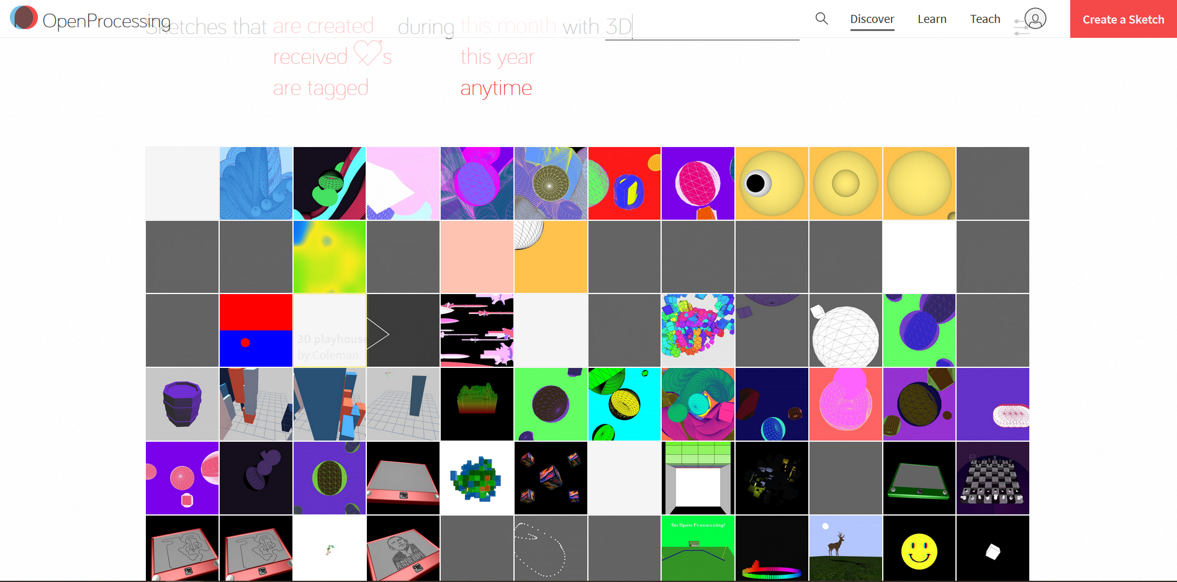
3D Sketches in OpenProcessing
3D sketches currently in OpenProcessing still rely only on 3D primitives, which doesn’t enable true possibilities in 3D space.

Slide 5
Idea
To build a 3D painting tool, first of which is to explore a 3D brush and provide users with ability to paint in 3D.
Core Features -
Preset of Brushes
Interactivity - Mouse & Keyboard | Camera-based Gesture <using the Gesture Library>
Color Picker in 3D <using 3D color picker>
Experimental - Generativity/Restrictions for Image based colors+
Import 3D Models, Save Sketches+
+ based on availability of time
Notes:
Computational Tool with a mix of Generativity

Slide 6

Proof of Concept
Simulating a 3D brush using 3D cube and Peasy Cam3D in WebGL.
Challenges - 3D camera orientation and mouse interactivity overlap

Slide 7
Implementation Challenges
3D Brush Class-
How to build a 3D brush(similar to pShape for 3D)
How to control the brush in 3D space, how to maintain the strokes in different dimensions
P3D or WebGL - Ability to seamlessly transfer and interact between 2D and 3D coordinate systems
Integration with existing library - PeasyCam3D and adding keyboard interactions

Slide 8
Design Challenges
Interactivity - to seamlessly blend keyboard(w,a,s,d) and mouse(mouse press, scroll)
Keyboard w,a,s,d - Move in 3D space
Mouse left click - to pen down the brush Mouse right click - color picker option (maybe) Mouse scroll - to pan in and out of the canvas
Lighting and Shading - the interaction of light with the 3D space will be challenges
Camera - Is moving camera a good idea(PeasyCam3D)

Slide 9
Evaluation Metrics
Ability to move freely and create 3D sketches
Ease of interactivity so that all three dimensions can be explored
Features to draw - Brush presets, Color Selection, 3D primitives

Slide 10
Feedback, thoughts and Critiques?
More metrics for evaluation?

